Slide 1
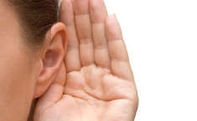
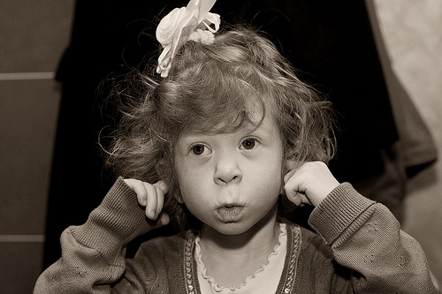
Ognian Mladenov
https://www.flickr.com/photos/oggin/11945521824/in/photolist-jczVsQ-9gzxuE-6H624e-6EWSPZ-2w9gy3-7DoGjh-dQRfVQ-eZEhKE-39mnmx-bpFXnZ-e2eix1-HE57z5-81bQma-oY8epG-dWSZG6-aB386u-5KSpJY-9bXcuw-5HMDNx-hmeCE2-8BJ2SX-5HMJDD-4Bd9Ef-85vydJ-qXt95Z-88hjnR-3xVQBq-8SSNhd-316tRW-8gH8wZ-oVKCD5-ftrft1-835q6W-5CEK3Z-9uNDtg-9rwP4i-6npLwL-6HAyfx-5qFwju-8BJ2cV-8SSN9y-5cPaBP-6jPTqZ-2rEhvr-7fPw44-eLM6Gs-8SSNih-8RUaEn-icXGGU-9a7fd7
-Picture is the stolen from Andrey Dorokhov's flickr page - this picture rocks - as do the rest of his shots.

Slide 2
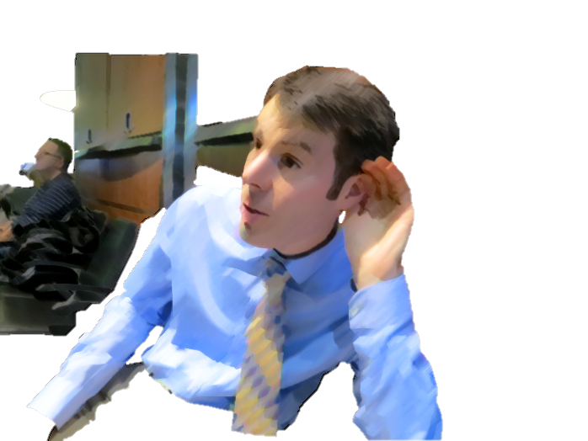
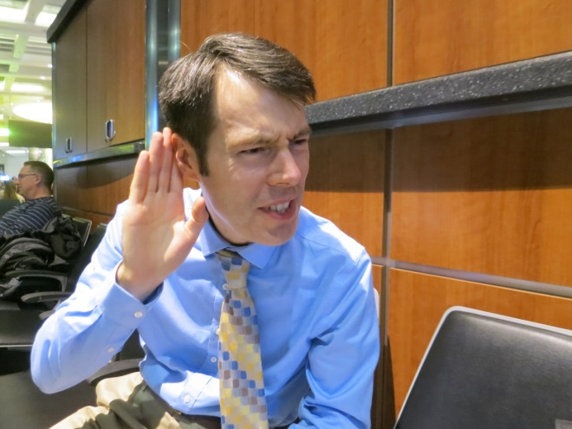
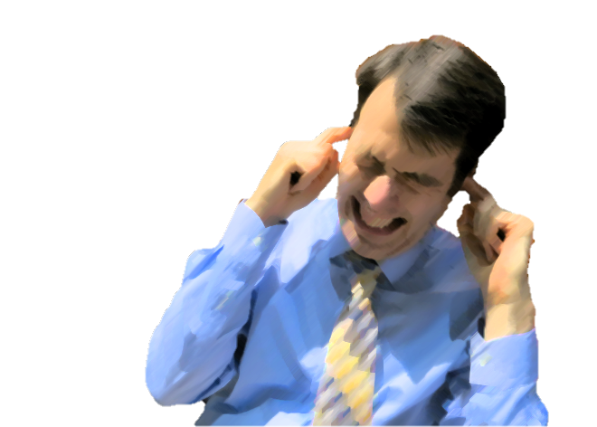
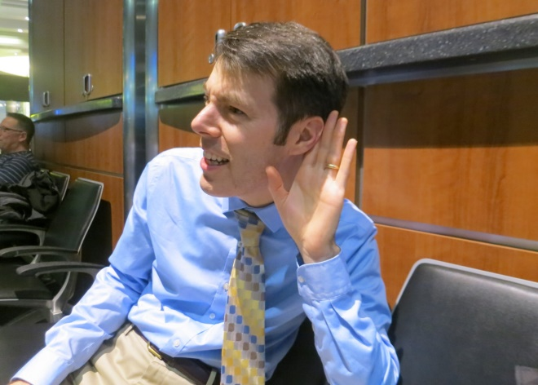
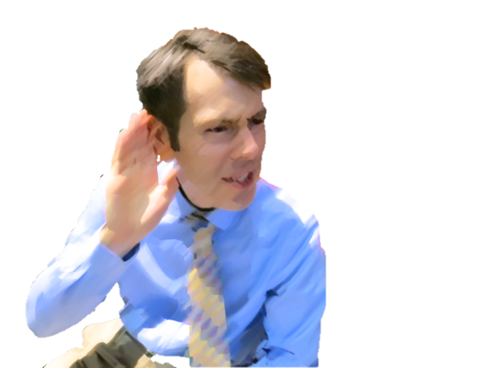
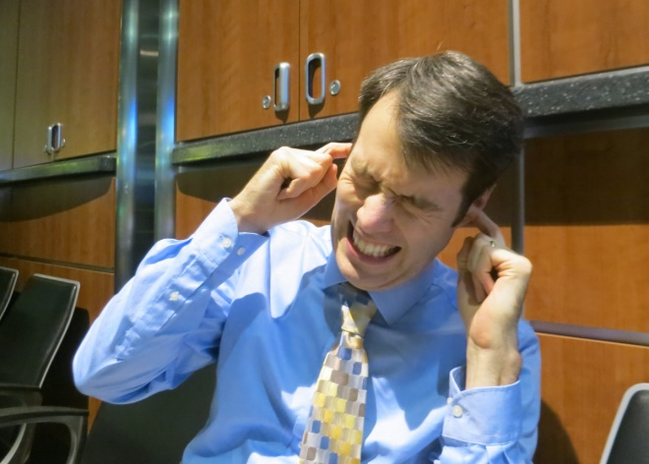
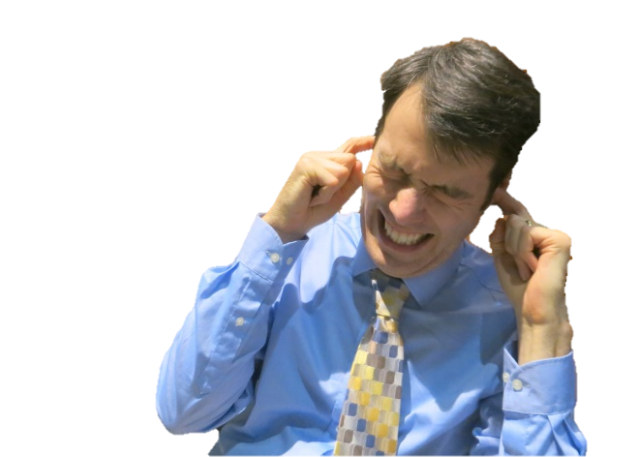
Too Quiet!
Too Quiet!
Too Loud!

Slide 3
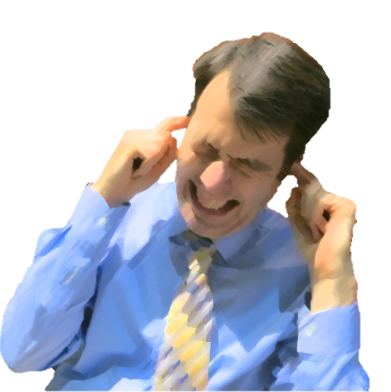
Too Quiet!
Too Loud!
Too Quiet!
Too Loud!
Too Quiet!
Too Loud!
Too Quiet!
Too Loud!

Slide 4
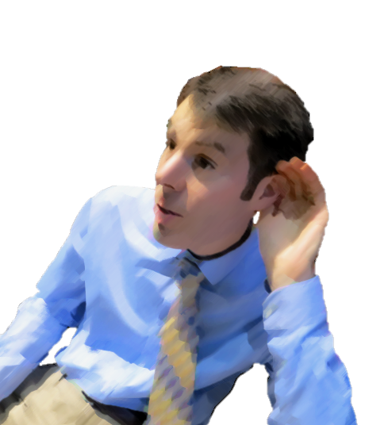
Too Quiet!
Too Loud!
Too Quiet!
Too Loud!
Too Quiet!
Too Loud!
Too Quiet!
Too Loud!

Slide 5
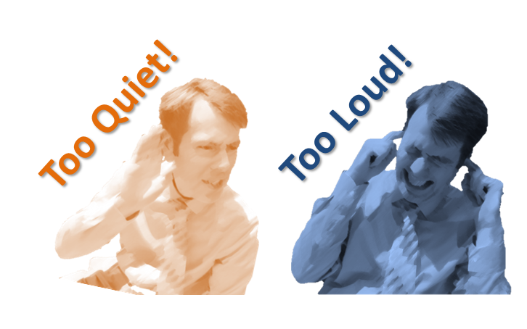
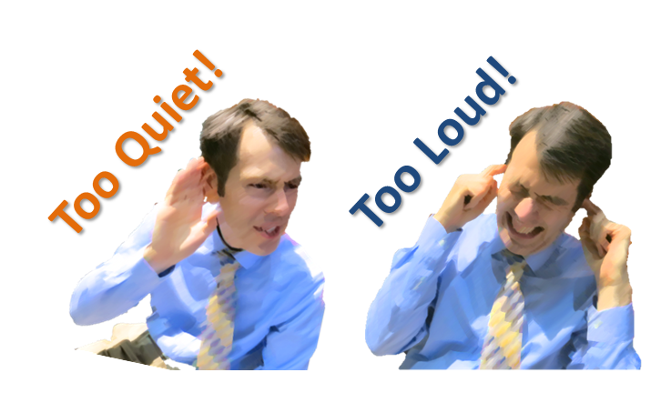
Pasted as Picture, Cropped to Size

Slide 6
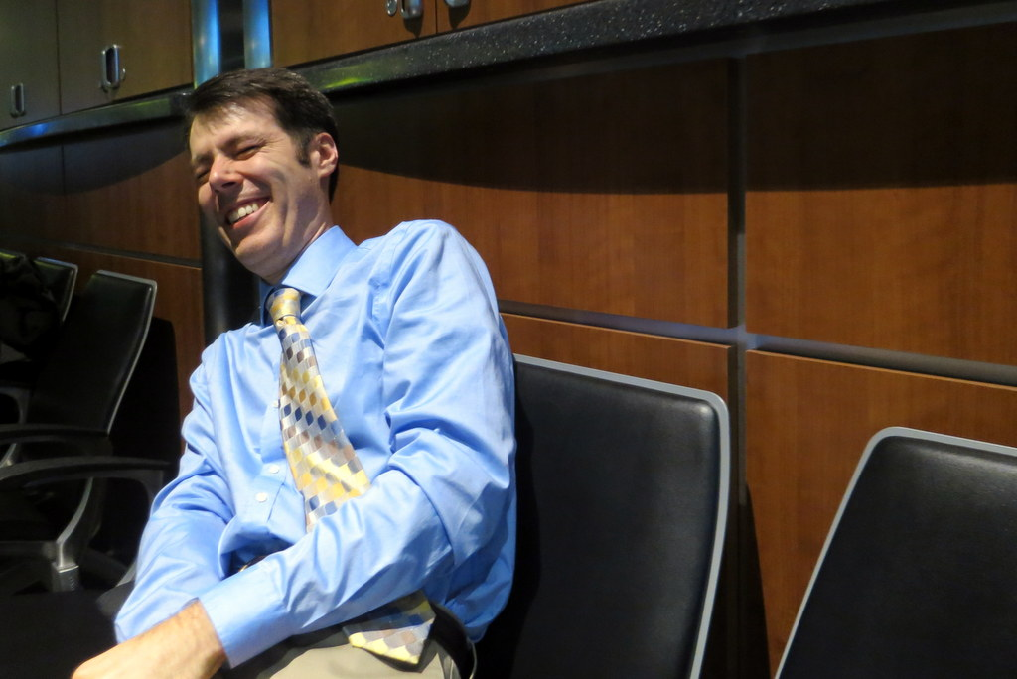

Slide 7
Normal Hearing
40dB Hearing Loss
140
Too Loud
140
Too Loud
120
Table Saw
120
Table Saw
100
Lawn Mower
100
Lawn Mower
80
Loud Restaurant
80
Loud Restaurant
Usable Range
Sound Level at Ear (dBA)
Conversation
Usable Range
Sound Level at Ear (dBA)
Conversation
60
60
40
Whisper
40
Whisper
Too Quiet
40 dB
Loss
20
Too Quiet
20
0
0
20
40
60
80
100
120
140
0
0
20
40
60
80
100
120
140
Sound Level (dBA)
Sound Level (dBA)
Linear Hearing Aid
30 dB Gain
Compression Hearing Aid
30 dB Gain, 2:1 Compression above 70 dBA
140
Too Loud
Table Saw
140
Too Loud
120
Lawn Mower
120
Table Saw
100
Loud Restaurant
100
Lawn Mower
2:1 Comp
Conversation
Loud Restaurant
80
80
Conversation
Sound Level at Ear (dBA)
Sound Level at Ear (dBA)
60
60
Whisper
Whisper
40
30dB Gain
Too Quiet
40 dB
Loss
40
30dB Gain
Too Quiet
40 dB
Loss
20
20
0
0
20
40
60
80
100
120
140
0
0
20
40
60
80
100
120
140
Sound Level (dBA)
Sound Level (dBA)

Slide 8
Original Audio
Dynamic Range Compressor
Prepare Signal
(Pre-Gain, HP Filter)
Level Estimator
(How Loud is It?)
Side-Chain Processing
Gain Calculator
(What gain do I want?)
Apply Gain
(Multiply)
Processed Audio

Slide 12
Compressed!
Compressed!
-15 dBFS
Linear

